Slide 1
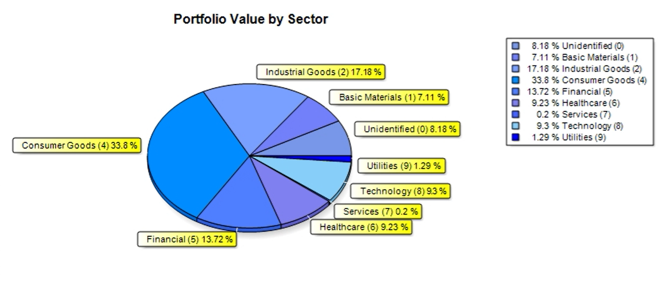
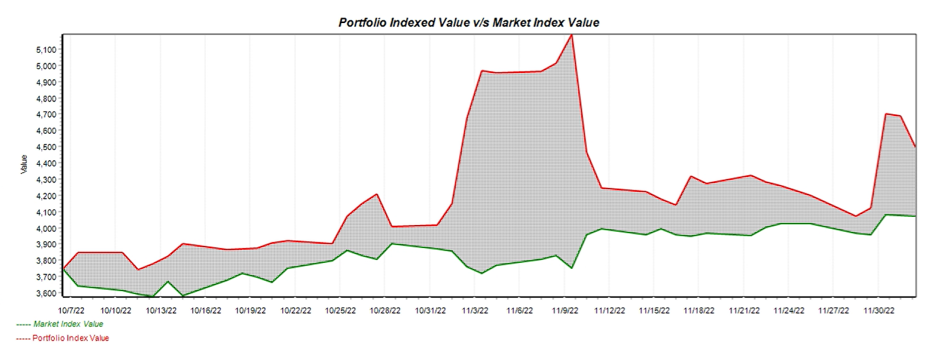
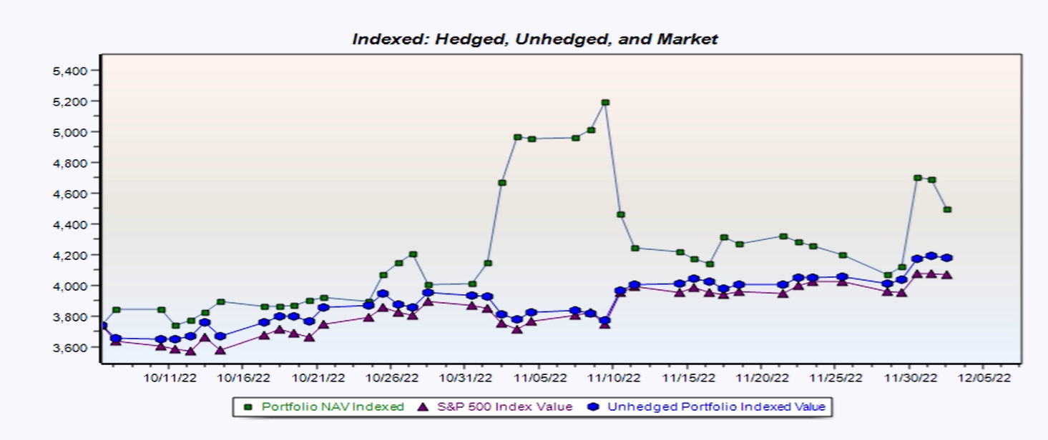
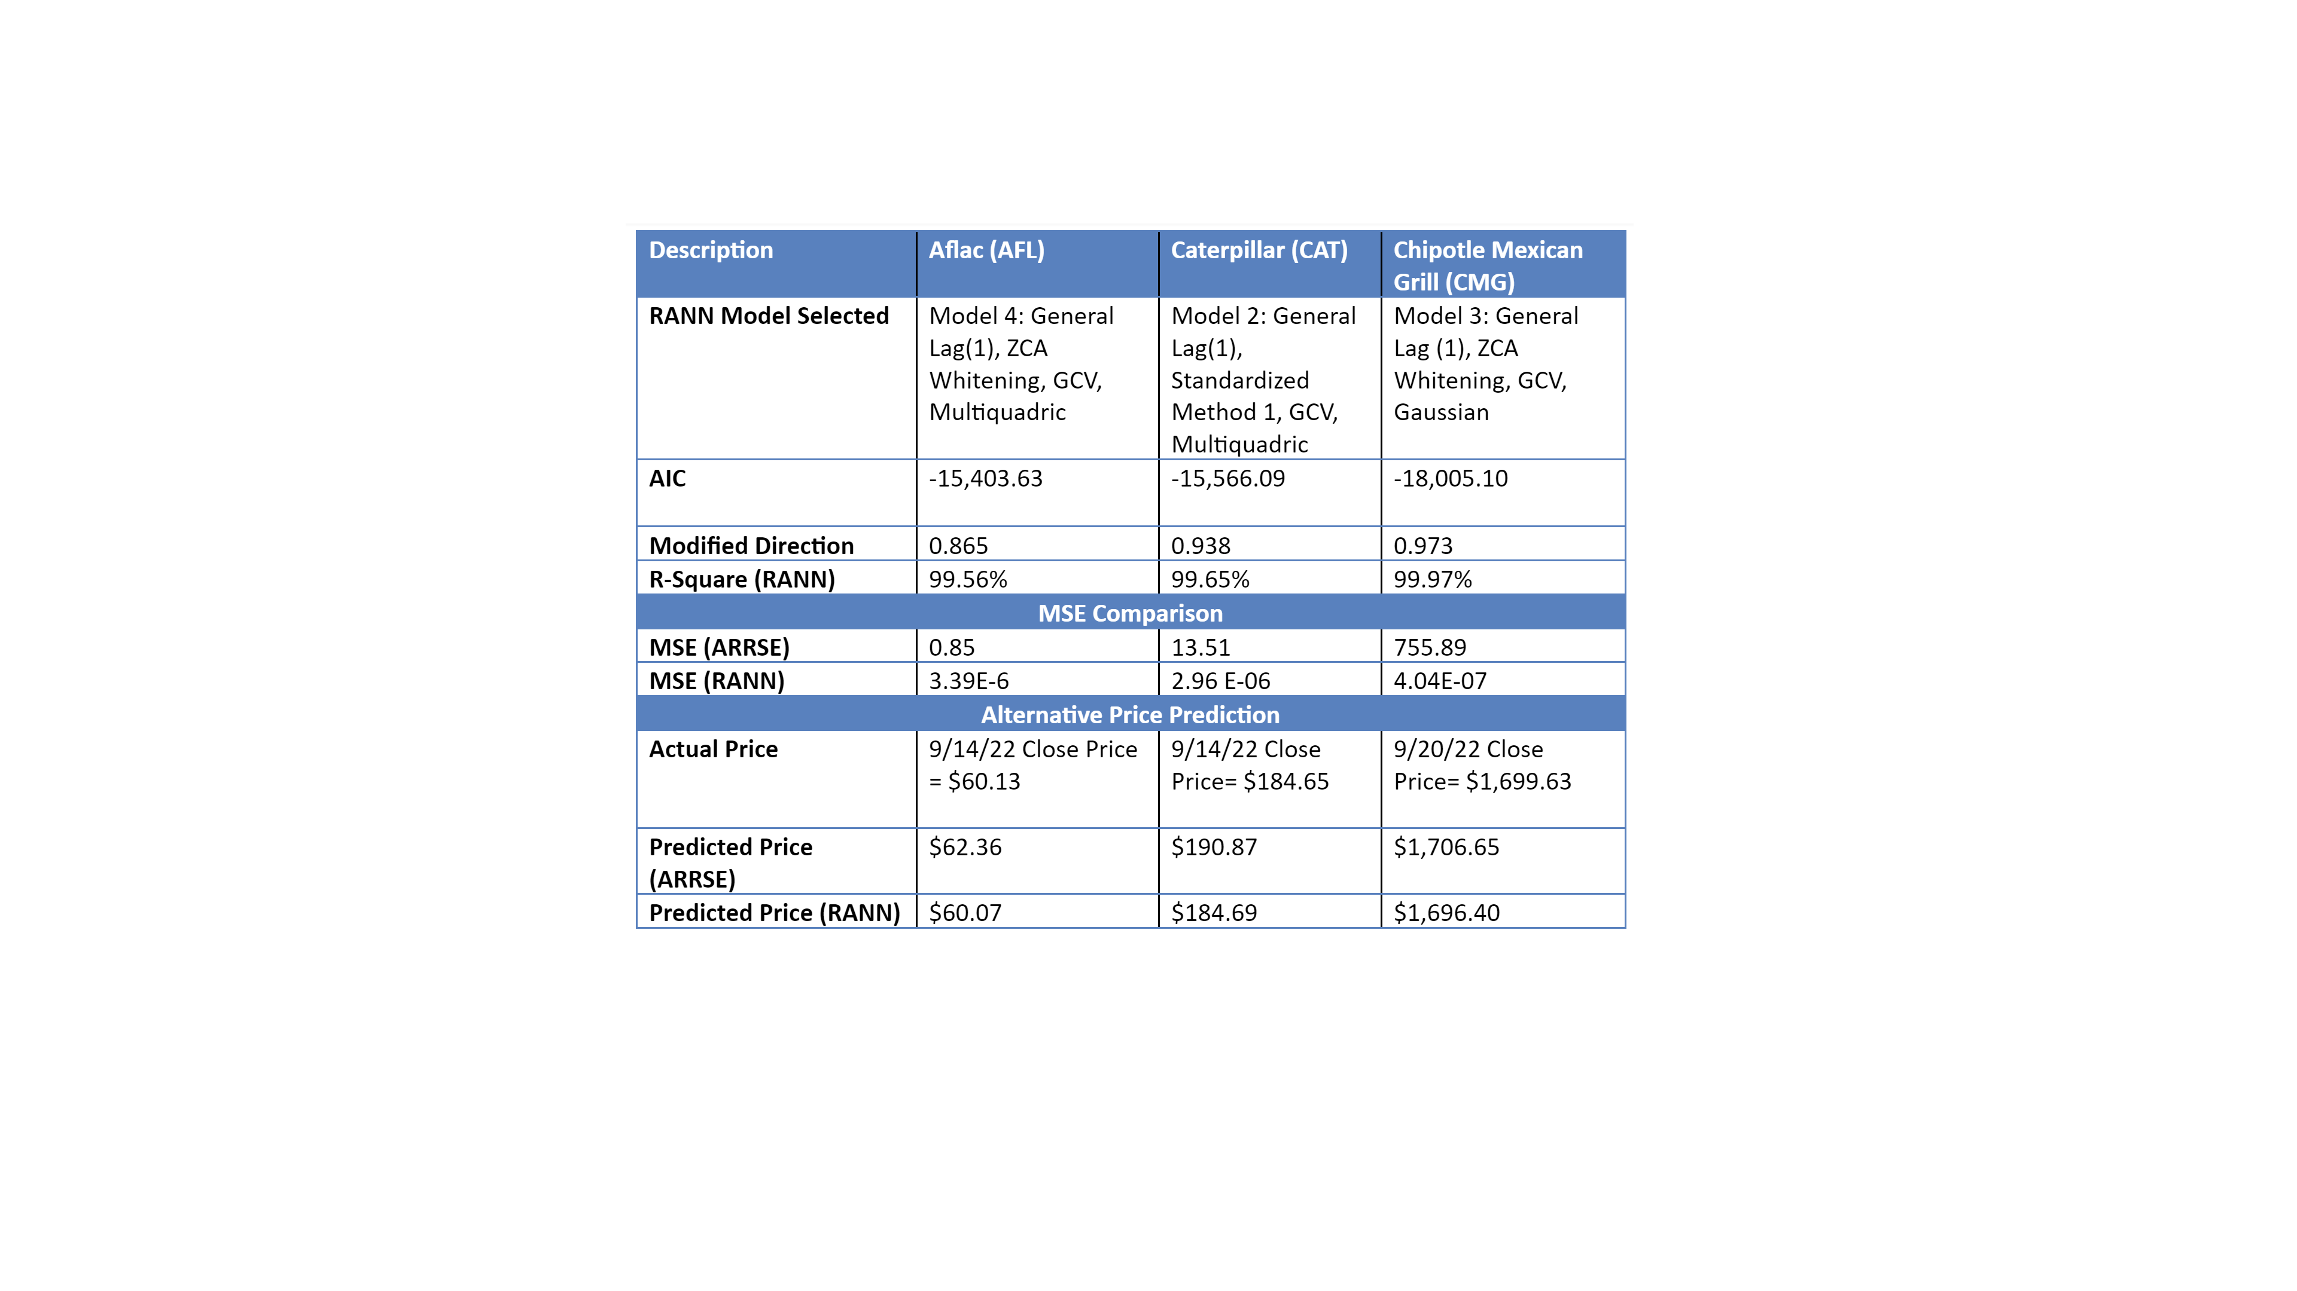
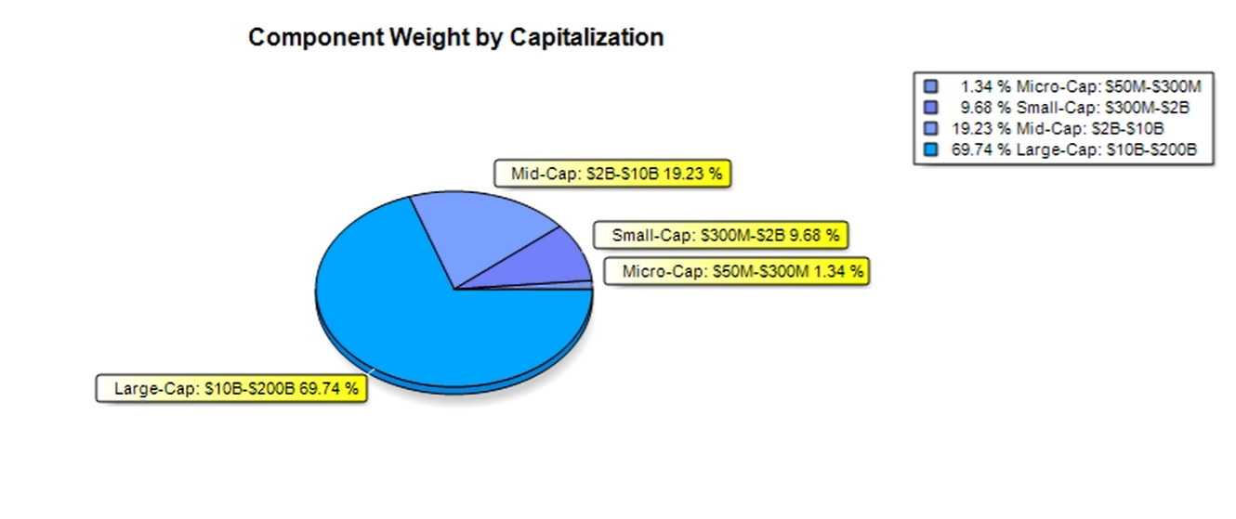
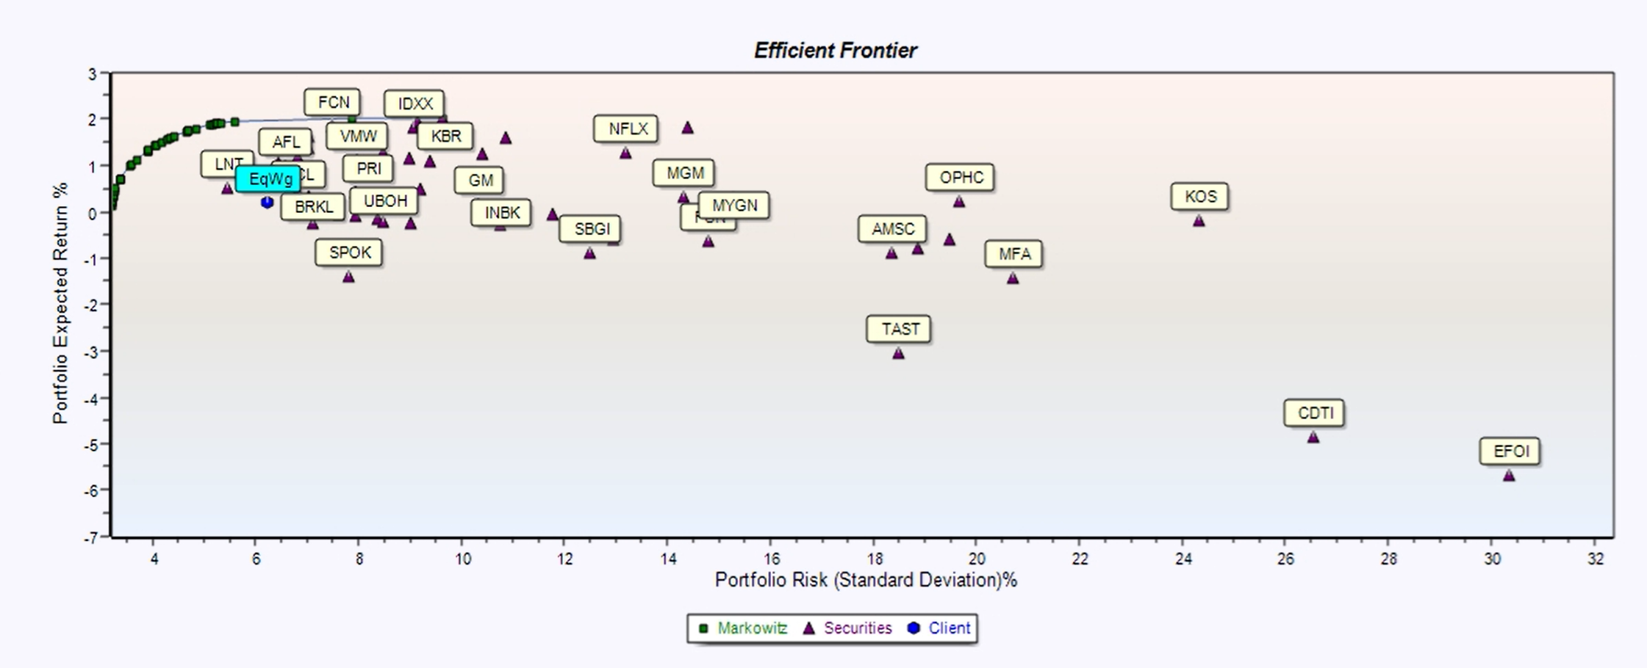
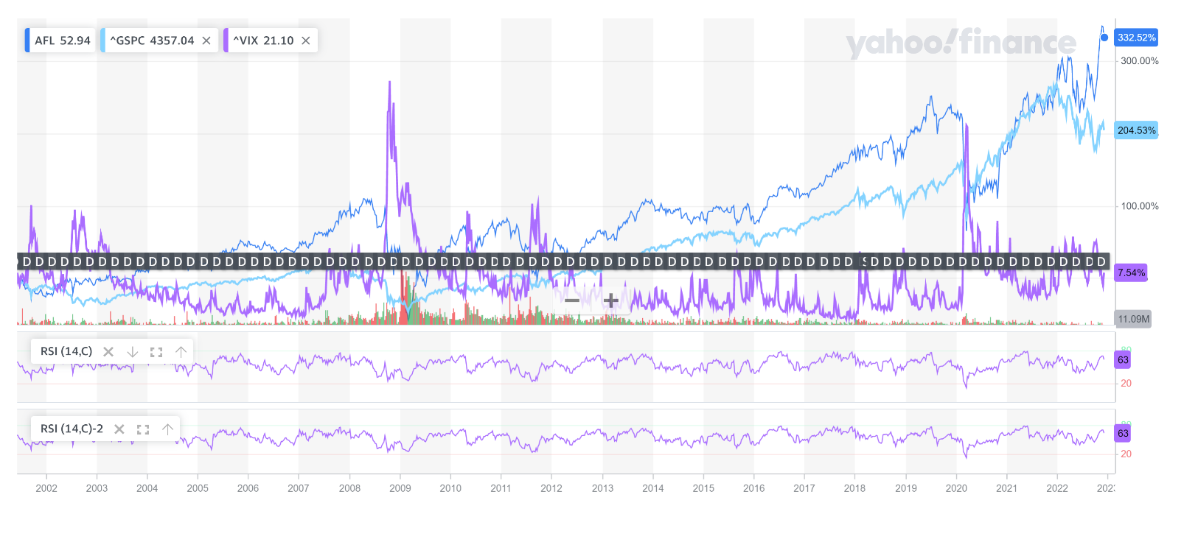
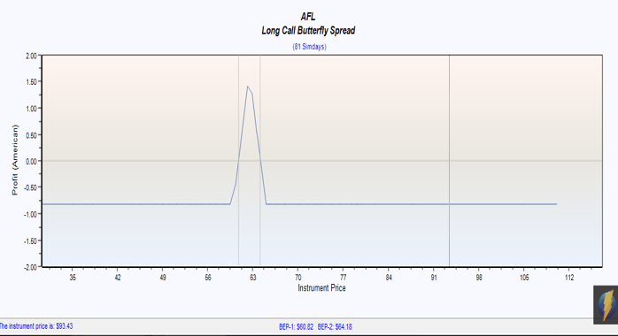
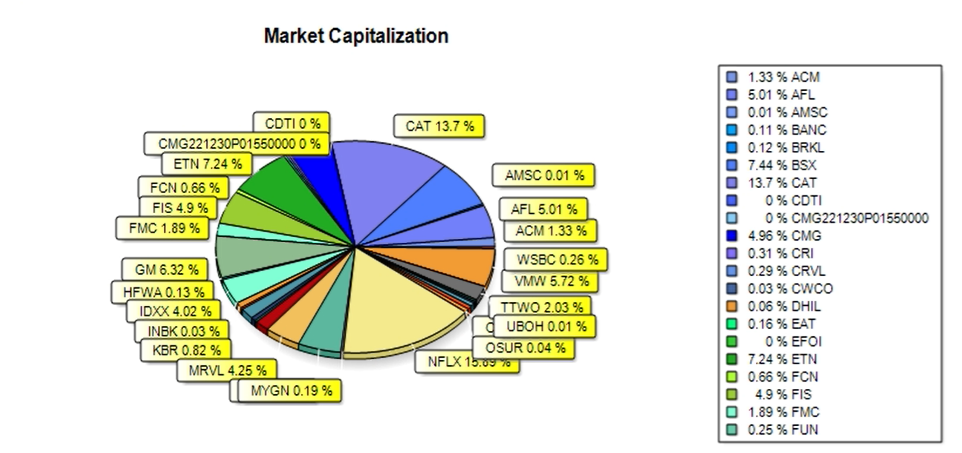
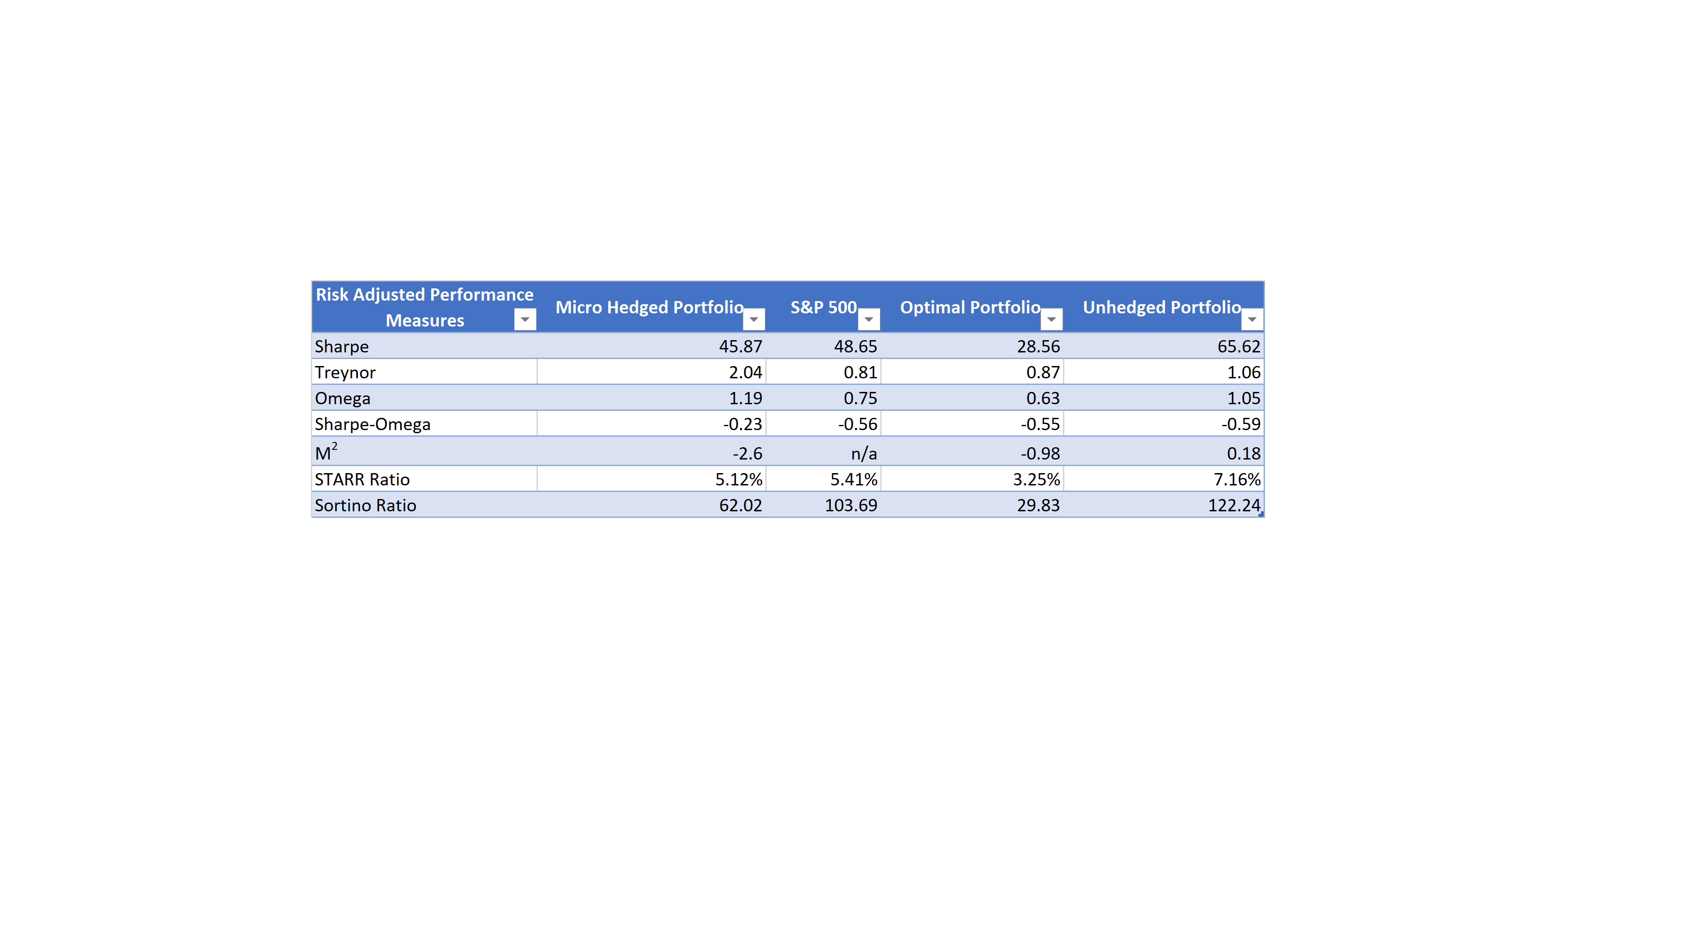
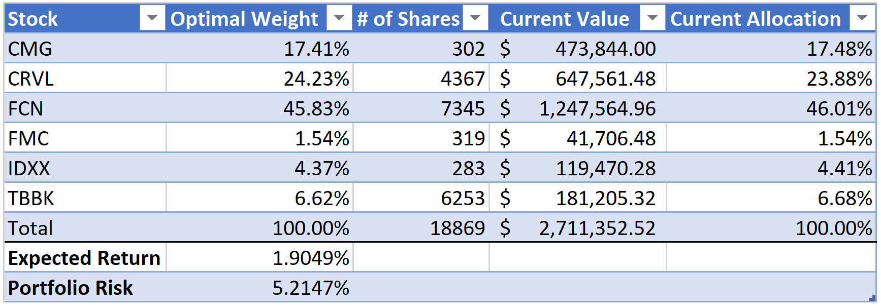
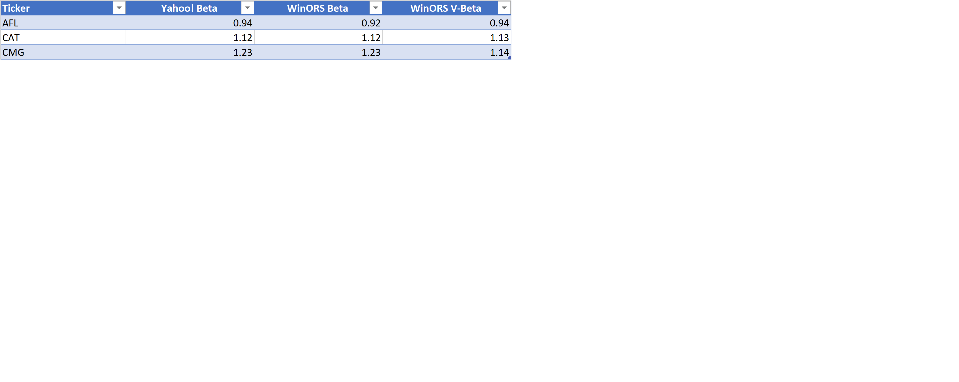
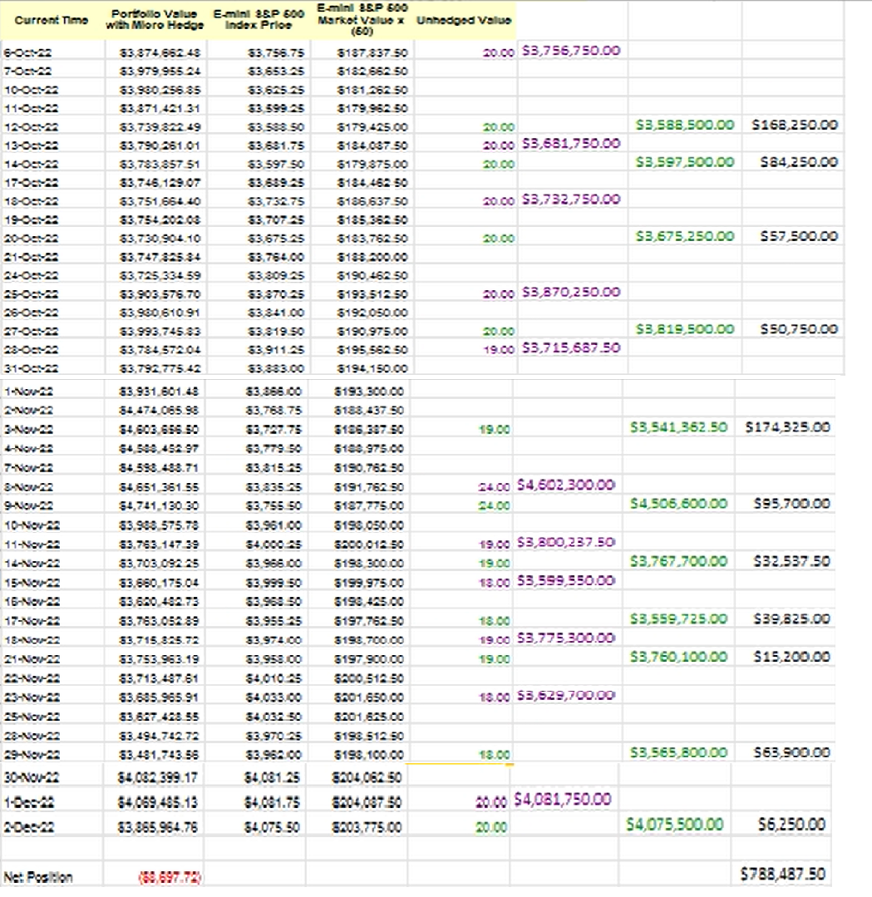
The State of Rhode Island Pension Fund
Created by Jason Fera, Joey LaCosta, and Sam Szumita
FIN421 Fall 2022 Term Project, MW 2:00-3:15
Introduction and Objective
VaR Analysis
Portfolio Value by Sector
Portfolio Comparisons
We will be assisting the state of Rhode Island by managing their pension fund. Since we will be handling the assets used to fund people’s retirement, we will focus on retaining the current capital on the fund and we will implement a conservative investment plan to avoid unnecessary risks. The fund is made of equities from various sectors. Our goal is to outperform the S&P500 by having a diversified portfolio and implementing risk mitigation strategies. We will also aim to have a monthly expected return of at least 1.25%.
 | Portfolio Return | S&P500 Index Return | Optimal Portfolio Return | Unhedged Portfolio Return
VaR @5% | $ 375,771.79 | $ 124.55 | $ 111,325.56 | $ 78,908.04
VaR Indexed @5% | $ 363.15 | $ 124.55 | $ 163.05 | $ 119.45
CVaR @1% | $ 503,062.25 | $ 167.55 | $ 142,474.03 | $ 111,244.65
CVaR Indexed @1% | $ 486.17 | $ 167.95 | $ 208.67 | $ 168.40
​​
VaR, value at risk, is a metric that quantifies the dollar possibility of a loss in the asset over a specific time frame. For example, our optimal portfolio of stocks has a one day 5% VaR of $111,325.56, then the portfolio has a 0.05 probability of falling by this amount, or more, on a given day. If VaR is negative, then it's implied that the portfolio has a 95% chance of making more than $111,325.56 the next day.
CVaR, conditional value at risk and known as expected shortfall, quantifies the amount of tail risk in an investment portfolio. CVaR is a weighted average of extreme losses in the tail of the distribution of possible returns. Extreme losses are those that occur beyond the VaR cutoff point, the worst case expected loss. For our optimal portfolio, the CVaR @1% shows us that our portfolio's worst case expected loss for a given day, with a probability of 1%, is $142,474.03. It makes sense that the CVaR is greater than the VaR of $111,325.56 because it is the greatest expected loss we could see in a day.
Ticker Analysis
Looking at the portfolio value by sector, we see the majority coming from Consumer Goods (33.8%). Our next biggest sector is Industrial Goods at 17.18%. This portion comes from only two stocks in the sector. Sectors such as Technology and Utilities were the opposite. For the Utilities sector, we have 9 stocks that make up only 1.29% of the overall value for the portfolio.
Equities in the consumer goods sector typically have lower volatility which is ideal for our portfolio since we are managing a pension fund.
In CAL 2 we ran several RANN models to try and predict the next day price of our tickers. In the table to the right are the models that predicted the closest predicted price to the actual price. The lowest fitness error is the model with the most accurate results. We also wanted the lowest AIC which is a measure of the amount of information lost by the model. We want R-Square to as close to 100% because R-Square is a measure of how the model explains the variance in Aflac returns. RANN was very accurate in determining the next day stock prices.
The graphs above show our hedged portfolio's performance against the performance of the S&P 500 index and the performance of our portfolio if we had not hedged. As we can clearly see our hedged portfolio vastly out-performed the market and our theoretical unhedged portfolio for the entirety of the semester, especially between 11/2 and 11/11. The importance of the hedge is apparent from day one, when we see the unhedged portfolio decrease in value, while our hedged portfolio increases its value. For example, on November 3rd, we hedged by purchasing 1900 futures contracts to offset the ones we sold on October 28th, creating $174,325 in profit that otherwise would not have existed without a hedging strategy.
Component Weight by Capitalization
Portfolio Efficient Set Analysis
Technical Indicator Graph
Looking at Component Weight by Capitalization, the portfolio consists of a range of equities from companies with large market capitalizations all the way to companies with micro market capitalization, however a lop-sided distribution. Most of our portfolio contains Large-Cap stocks, making up 69.74%. Next comes Mid-Cap stocks, accounting for 19.23% of the portfolio. Our portfolio contains little Small and Micro-Cap stocks, however, having stocks in all different areas lets us further our overall portfolio diversification.
Recommended Spread Strategy
Market Capitalizations
The graph above is comparing Aflac, to the S&P 500 and the VIX. Aflac generally moves in the same direction as the S&P 500. The two have very similar patterns in peaks and troughs which tells us they have a relationship. The VIX shows market volatility and there doesn’t appear to be an obvious relationship between the VIX and Aflac. Aflac is not a very volatile stock. Our technical indicator is the RSI which charts current and historical strength or weakness of a stock or market based on the closing prices of a recent trading period. Aflac has an RSI of 63 which falls on the higher end of our chosen range of 20-80. This may mean Aflac is slightly overbought.
The efficient frontier represents the optimal trade-off between risk and expected return an investor faces when forming an investment portfolio. The X-axis shows the portfolio risk represented by standard deviation and the Y-axis is the portfolio’s expected return. In this case we are using the Markowitz model, which is a process that, given an expected return level, will find the asset weights that produce the lowest possible portfolio risk. When analyzing the efficient frontier chart, we look at all the combinations of risk and expected return for each possible portfolio. The closest equities to the Efficient Frontier have the potential to produce the greatest return with a low degree of risk.
Performance Measures
Our focus ticker Aflac has a relatively low volatility with a 31.1% annualized realized volatility and a standard deviation/volatility of 5.05%. I explained what the long call butterfly spread is in a previous section, but this strategy is best suited for stocks with a moderate to low volatility. The upside-down V shaped graph with two breakeven points that are less than $4.00 apart shows why this would be a good strategy for a stock like Aflac. For these reasons we are choosing the Long Call Butterfly Spread as the optimal strategy for Aflac.
In the chart above we find the market capitalization pie chart for our entire portfolio. In the table to the right of the pie chart, we have the breakdown of percentages of each option in our portfolio. As you can notice, certain stocks such as CAT at 13.7%, ETN at 7.24%, and BSX at 7.44%, have a much higher percent of market capitalization than some of the others in our portfolio. Market Capitalization is defined as the value of a company traded on the stock market by multiplying shares outstanding by current stock price. We can also relate our pie chart to the component weight by capitalization pie chart above. The market capitalization takes into account share price whereas the chart above does not. However, you can predict the market cap based on the weights, as the more weight in the portfolio, most likely the more market cap you will have.
Optimal Portfolio
To start, the Sharpe ratio performance measure measures performance of an investment in a portfolio compared to the risk-free asset, adjusted for risk. Our Sharpe measure of 45.87 in our portfolio is quite close to the S&P at 48.65. Next, the Treynor measure which is the performance metric for determining how much excess return generated for each unit of risk in the portfolio. Our portfolio has a Treynor measure of 2.04 compared to the S&P at 0.81, meaning our portfolio has a higher Treynor measure by over 2.5 times which is beneficial for our portfolio. Next, the Sortino ratio takes an asset or portfolio's return and subtracts the risk-free rate, and then divide the amount by the downside deviation. Our portfolio has a 62.02 Sortino ratio to the S&P's 103.69 which is a 41.67-unit difference. We will want to increase our Sortino ratio significantly to get on par with the S&P 500. The other performance measures in our table are on par with the S&P 500 which is a sign that our portfolio will have positive return and will be successful at generating return.
Ticker Betas
Futures Hedge
The table to the left shows the futures hedge we implemented from 10/6/22 to 12/2/22. Through a process of selling futures contracts and offsetting by purchasing futures contracts we were able to successfully hedge the portfolio. We experienced a $8,697.72 loss in our net position, but thanks to our futures hedge that generated $788,487.50, we ended up with a net gain of $779,789.78. The use of derivative contracts makes it possible to measure and control for risk in an underlying investment asset.
Above is a table of our optimal portfolio. The portfolio is comprised of six securities: CMG, CRVL, FCN, FMC, IDXX, and TBBK. FCN and CRVL have the highest weights in the portfolio and it's interesting to see that they are both consulting and risk management firms. The optimal portfolio has a monthly expected return of 1.9049% which satisfies one of our goals of having a monthly expected return of at least 1.25%.
The portfolio risk of our optimal portfolio is 5.2147%. This is an acceptable risk for our investment objectives and goals. We will implement a futures hedge and diversify to help reduce this risk and maximize our returns.
Summary
In conclusion, we believe that hedging is essential to managing a portfolio. Especially in this situation of managing a pension fund, it is most important that we protect people's money and can promise a rate of return at or above the risk-free rate. Using the WinORS software, we were able to create a diverse portfolio, with equities in many different sectors and market capitalizations. We were able to protect our portfolio from possible dips in the market by implementing our futures hedge. This futures hedge not only protected our investments but created additional profit. By emphasizing hedging and diversification, we were able to produce a portfolio that outperformed the market.
The table above shows the Betas of the tickers of our group. The three different measures of Beta that we’ve used have very similar values. Out of the three tickers AFL has the lowest Beta which means it has the lowest systematic risk while CMG has the highest systematic risk. V-Beta is an adjusted Beta that accounts for the tendency of Beta to move towards the Beta of the market over time.
References
Applied Risk Management:Valuation of Derivatives under AI and Data Science Technologies: Gordon H Dash and Nina Kajiji
https://www.investopedia.com/
https://finance.yahoo.com/
Notes:
Sections with updated charts/graphs: Portfolio efficient set analysis, portfolio value by sector, portfolio distribution by sector, beta depth chart, portfolio index values
Fully Completed Sections: intro and objective, ticker analysis, recommended strategy, ticker betas, VaR analysis, optimal portfolio, portfolio value by sector, component weight by capitalization, futures hedge, technical indicator
Needs to be completed: Portfolio efficient set analysis, Beta depth chart, portfolio comparisons, performance measures, summary, references

